Slide 1
BRIEFING SESSION: FOR RFI TO ENABLE TRANSNET TO IDENTIFY A SERVICE PROVIDER TO ASSIST IN THE RECOVERY, UPGRADE, AND LONGTERM SUPPORT OF THE CLASS 20E, 21E, AND 22E LOCOMOTIVE FLEETS. HOAC HO 49860
THEREAFTER
THROUGH A SEPARATE “REQUEST FOR PROPOSAL” [RFP] PROCESS
TO APPOINT NATIONAL SERVICE PROVIDERS TO UNDERTAKE THE PROVISION OF RECOVERY, UPGRADE, AND LONG-TERM SUPPORT OF THE CLASS 20E, 21E, AND 22E LOCOMOTIVE FLEET OVER AN AGREED PERIOD
Presented
By: Buyisiwe Hlatshwayo
1

Slide 2
TABLE OF CONTENTS
Housekeeping
Welcome & Introduction
Purpose of the Briefing Session
Tender Process
Technical Requirements
Questions & Answers
Closure

Slide 3
PURPOSE OF THE BRIEFING SESSION
The purpose of this briefing session is to make sure that all Respondents understand what is expected of them with regards to the RFI process or any other areas that require clarity to the RFI.
01
Minutes of the briefing session will be sent to all in attendance of the briefing session upon request.
02
No questions will be taken during the presentation and will only be accepted under the ‘Questions and Answers’ session. However, all questions must be submitted in writing for a formal written response to be provided by TFR.
03

Slide 4
TENDER PROCESS
Respondents must ensure all the required returnable documents are submitted with their proposals – Section 3: Tender document. The below documents must be submitted with the bid documents:
    RFI
    SBD1 Form- Must be completed in full and clear hand writing
    ANNEXURE A TECHNICAL SUBMISSION/QUESTIONNAIRE- Please utilize this Annexure to respond to the questionnaire
    ANNEXURE B NON-DISCLOSURE AGREEMENT
    ANNEXURE C TRANSNET’S GENERAL BID CONDITIONS
    ANNEXURE D SUPPLIER INTERGIRITY PACT

Slide 5
TENDER PROCESS (CONT)
The RFI deadline for questions /clarifications is before 12:00pm on the 20th of FEBRUARY 2025. These can be directed to Buyisiwe Hlatshwayo via e-mail:- buyisiwe.hlatshwayo@transnet.net
Response to questions / bid clarifications will be sent to all Respondents.
Proposals / tender documents have to be submitted on or before the tender closing, which is 11h00 am (Central Africa Time), 27 FEBRUARY 2025 on the tender portal.
All documents submitted must be cross referenced to the relevant section of the RFP

Slide 6
TENDER PROCESS (CONT.)
After the closing date Respondents are NOT to communicate with TFR employees and are to direct all clarifications / questions to the DBAC Secretariat , Prudence Nkabinde, Prudence.Nkabinde@Transnet.net 011 584 0821.

Slide 7
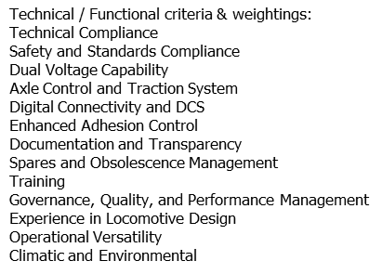
TENDER PROCESS (CONT.)
STAGE 1:
TEST FOR RESPONSIVENESS
STAGE 2
STAGE 3
Step 1
Step 2
Step 3
Step 4
Administrative responsiveness
Substantive responsiveness
Returnable documents/ schedules
Functionality/ technical
80% Minimum Threshold
SS
Pre-qualification
Shortlisting
of bidders to
move to the
RFP stage.

Slide 8
TECHNICAL REQUIREMENTS

Slide 9
Thank you

Slide 10

QUESTIONS & ANSWERS
  Questions & Answers

